Slide 1
Estimation of Concentration Index (CI), Concentration Curve &
Decomposition of CI

Slide 2
Learning Objectives
Understand the concentration curve and the concentration index as measures of socioeconomic inequality.
Estimation of CI by different methods.
Handle binary outcomes: bounds, Wagstaff normalization, Erreygers index.
Demographic standardization of CI.
Decomposition of CI (Wagstaff decomposition).
Practical example using STATA.

Slide 3
Concepts
Concentration curve and the CI

Slide 4
In general, a concentration curve plots the cumulative % of the health variable against the cumulative % of the population ranked by socioeconomic status.
Concentration Curve
Curve above the diagonal →
concentration among the poor
Curve below the diagonal →
concentration among the rich
Curve on the diagonal = equality

Slide 5
Graphing concentration curves from grouped data
Rank individuals/HHs by living standards variable, into quintiles (or deciles).
Obtain for each quintile the mean of the variable of interest.
Paste quintile means and counts into Excel; form cumulative % relevant cases and corresponding. cumulative % of total value of variable of interest; graph concentration curve using xy chart.

Slide 6
Example of a Concentration Curve Derived from Grouped Data

Slide 7
Graphing the concentration Curve for individual data
The advantage of the concentration is that it can be computed from individual-level data and so gives a picture of the complete distribution.
Steps:
Order individuals by SES rank x (poorest → richest)
x-axis: cumulative population share p ∈ [0,1]
y-axis: cumulative share of outcome y (non-negative)
Equality line L₀(p)=p; pro-rich (good) ⇒ L below 45°, pro-poor ⇒ above.
L(p) is the total percentage of y that falls to the bottom p by SES rank.

Slide 8
Graphing the concentration Curve L(p) for individual data (STATA commands)
glcurve y, glvar(yord) pvar(rank) sortvar(x)
or use twoway graph routines to plot the coordinates yord & rank.
(Will show in STATA example)
Notes:
If individual level data are available, it would be silly to graph a concentration curve from the quintile or decile cumulative frequencies. One would be throwing information away and producing only an approximation to the concentration curve. Better to compute the cumulative frequencies from the individual level data, with individuals ranked by the living standards variable.
The example shows the concentration curve for the negative of the height-for-age z-score (haz) in Vietnam in 1993 and 1998 from the respective Vietnam Living Standards Surveys. The more negative is haz, the less well nourished is the child. Since we take the negative haz, a higher number indicates greater malnutrition. Children are ranked from left to right by household consumption per capita.
Both curves lie above the diagonal indicating that malnutrition is concentrated on the poor in both years.
For the first two-fifths of the income distribution, there is little or no difference between the concentration curves, indicating that the degree of concentration of malnutrition on the poorest children did not change over time. But further up the distribution, the 1998 curve lies outside that of the 1993 curve suggesting that child malnutrition was more unequally distributed in the later year.
In Stata, concentration curves can be drawn using the ado glcurve. glvar() gives a name to the y-ordinate of the graph and pvar() to the x-ordinate. These are saved and can be used later. The x-ordinate is the individual’s fractional rank in the living standards distribution. sortvar() declares the variable on which individuals are to be ranked. replace instructs Stata to write over the pvar() variable that will already exist if the command had been run previously. by() requests separate curves split by the dichotomous variable (year). lorenz requests that the y-ordinates of the curve are scaled by the mean of the variable, such that cumulative shares are plotted. If this is left out then a generalised concentration (Lorenz) curve is plotted, i.e cumulative means on the y-axis.
For more control of the appearance of the graph, the y- and x-ordinates can be passed to twoway.

Slide 9
Fractional Rank
Definition, construction, and derivation

Slide 10
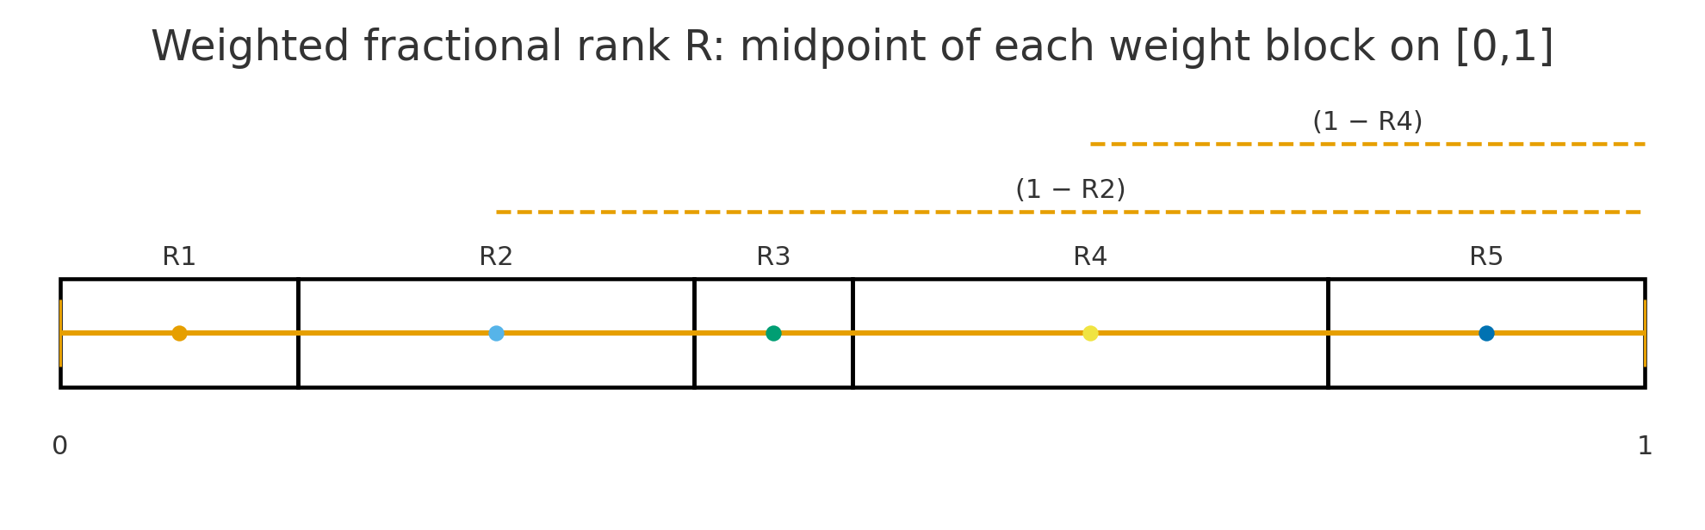
Fractional Rank on [0,1] Ruler
Lay the population on a ruler from 0 (poorest) to 1 (richest); each person occupies a slice (bigger if survey weight is larger). Your fractional rank is the midpoint of your slice.
I.e., fractional rank is a person’s position on a 0–1 scale after sorting everyone by socioeconomic status.

Slide 11
Definition (Weighted Mid-Rank/ cumulative share)
What it is: The cumulative share of the population up to person 𝑖 plus half of its own share.
Unweighted formula: Ri = (i − 1/2) / n (people numbered 1..n after sorting by SES).
Weighted formula: Let weights wᵢ, total W=Σwᵢ, and cumulative before i be S_{{i−1}=}Σ_{{j<i}} w_{j.}
Fractional rank: Rᵢ = (S_{{i−1}} + 0.5 wᵢ)/W ∈ (0,1)
Key property: weighted mean E[R] = 1/2.

Slide 12
Why E[R]=1/2 (Proof)
E[R] = (1/W) Σ wᵢ Rᵢ
= (1/W²){ Σ wᵢ S_{{i−1}} + 0.5 Σ wᵢ² }
Σ wᵢ S_{{i−1}} = Σ_{{j<i}} w_{i} w_{j} = 0.5[(Σ wᵢ)² − Σ wᵢ²]
Therefore E[R] = (1/W²)·0.5·W² = ½
Ensures the (weighted) average rank equals ½.

Slide 13
Estimation of Concentration Index
From Geometry to Covariance

Slide 14
Concentration index (CI)
CI = 2 x area
between 45⁰ line and
concentration curve
CI < 0 when variable
is higher amongst poor
Notes:
7
The concentration index provides a summary measure of the magnitude of socioeconomic-related inequality in a health variable of interest.
Comparing a set of numbers can give a clearer ranking when trying to compare inequality across a number of countries, regions or time periods. But must acknowledge that the index loses information relative to the concentration curve. It summarises the distribution in one number of so does not indicate at what points in the distribution there are departures from proportionality. The concentration index should be used in tandem with the concentration curve.

Slide 15
Concentration Index (CI)
CI ≡ 1 − 2 ∫₀¹ L(p) dp (twice the signed area between equality and L(p)).
C lies in range [-1,1]
C= 1 if the richest person has all of the health variable.
C= -1 of the poorest person has all of the health variable.
Sign shows direction of inequality.

Slide 16
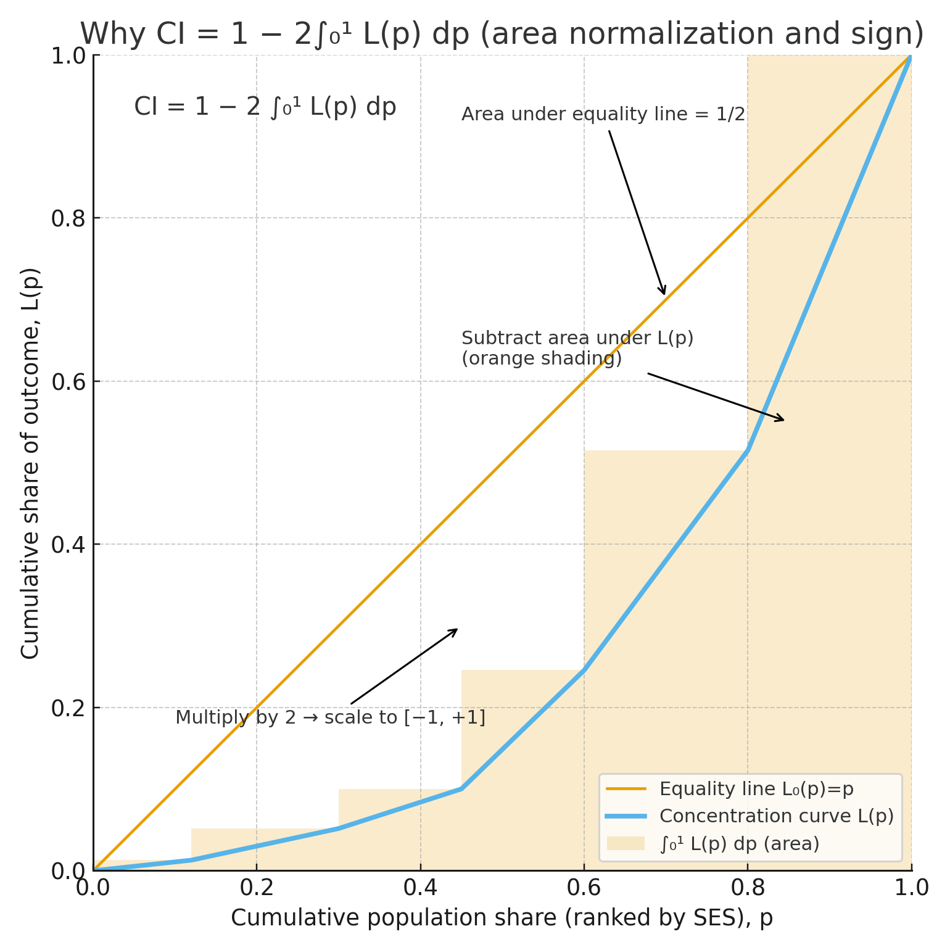

Slide 17
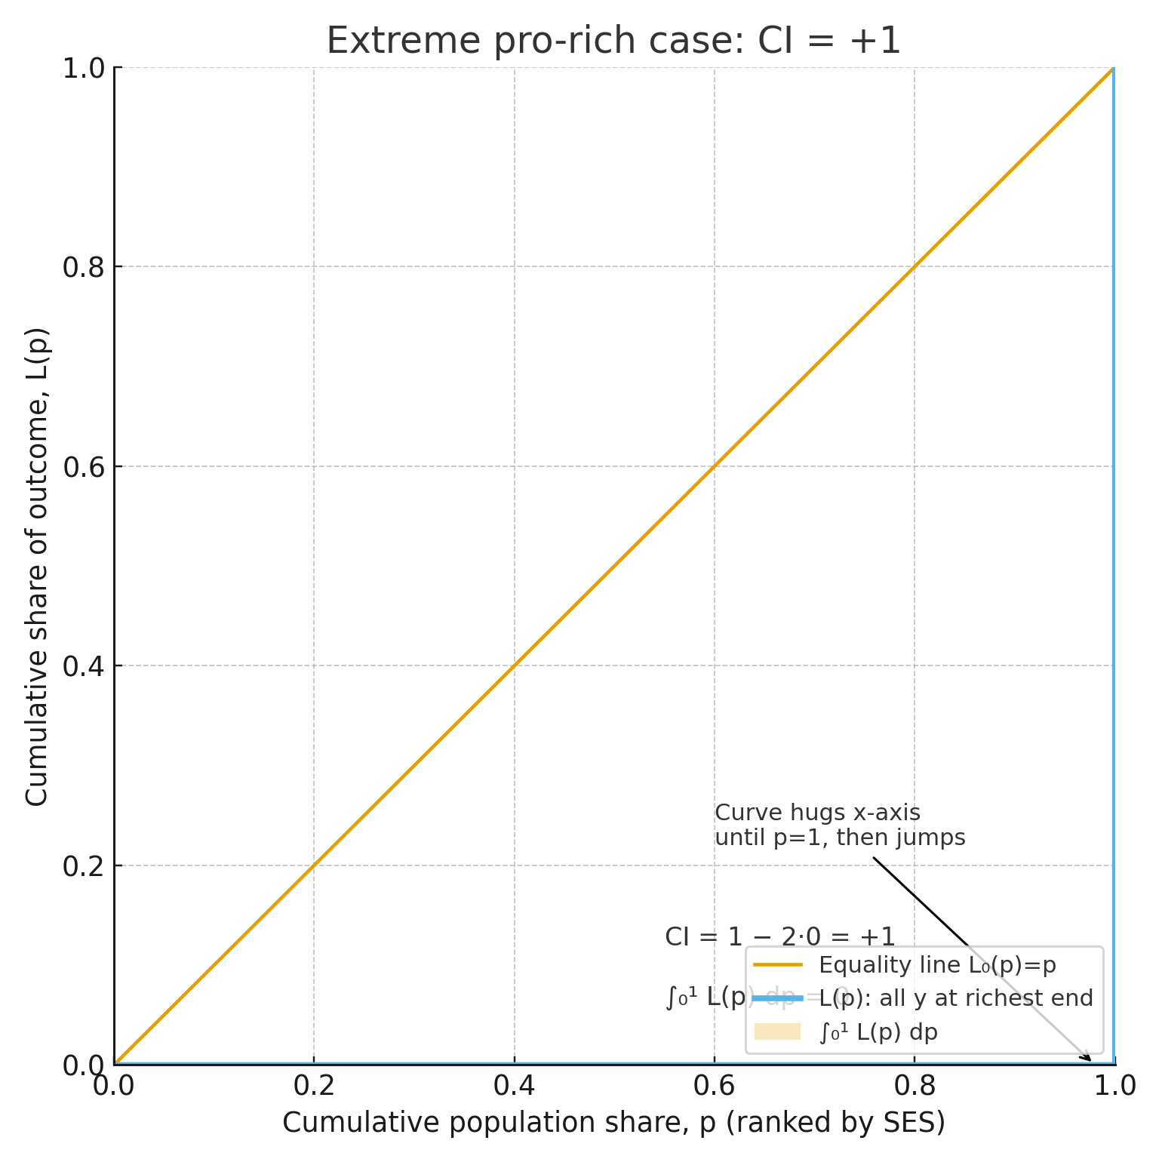

Slide 18
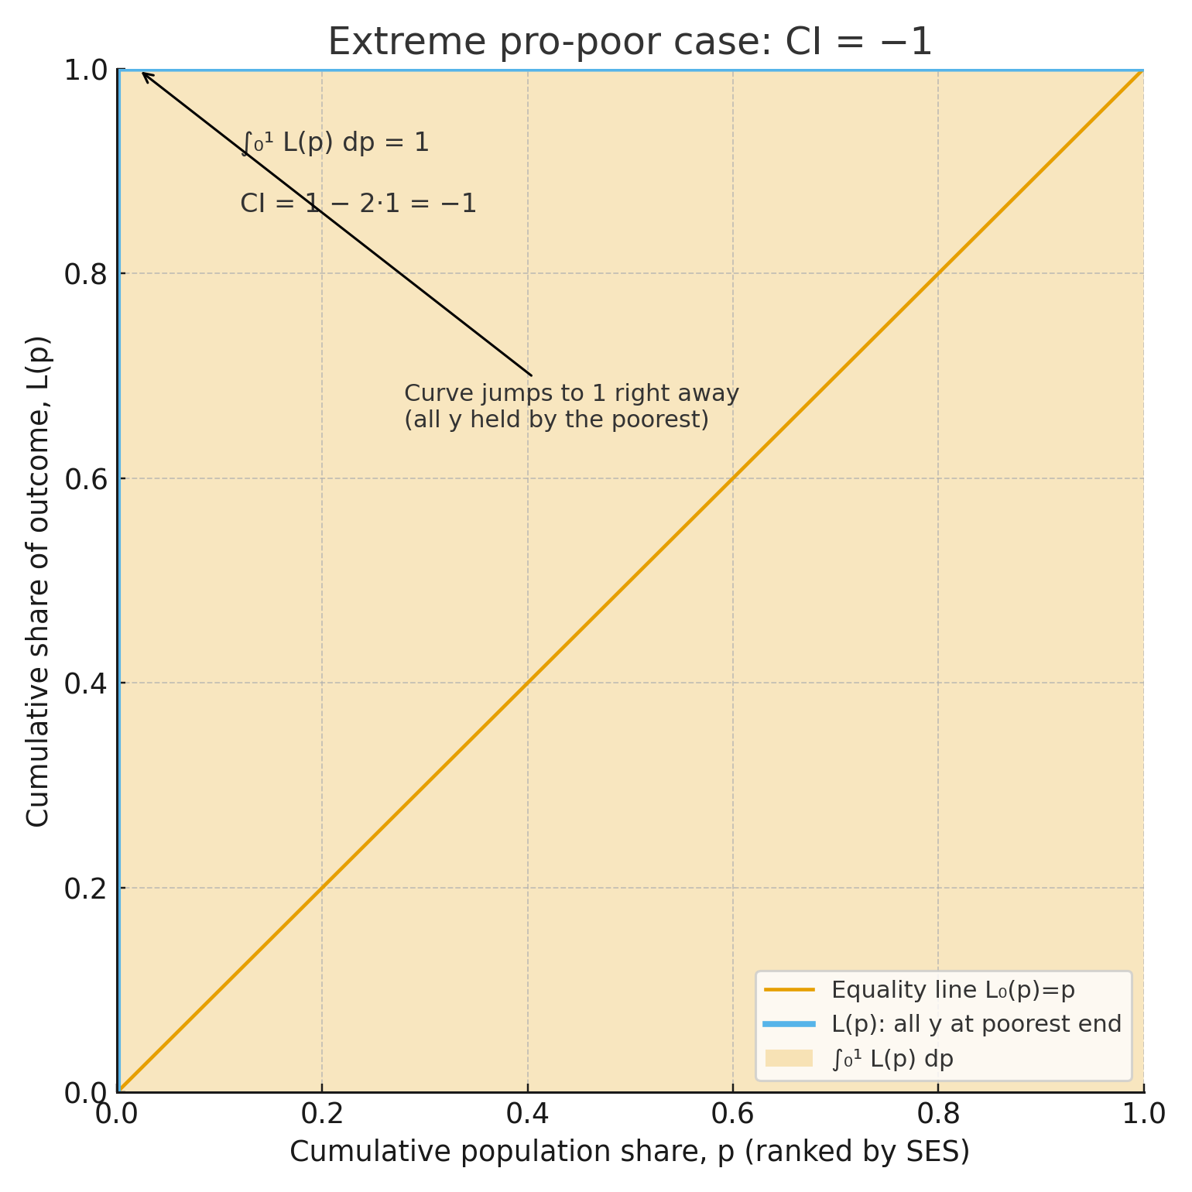

Slide 19
Concentration Index (CI) from Grouped Data
Definitions (group k, ordered poorest to richest):
  p_{k} = cumulative population share up to group k (e.g., cumulative % births).
  L_{k} = cumulative outcome share up to group k (e.g., cumulative % deaths).
  Include the origin: (p₀, L₀) = (0, 0) and the end point (p_{K}, L_{K}) = (1, 1).
Concentration Index is given by the following formula
  CI = Σ (p_{{k-1}}L_{k} − p_{k} L_{{k−1}})
.

Slide 20
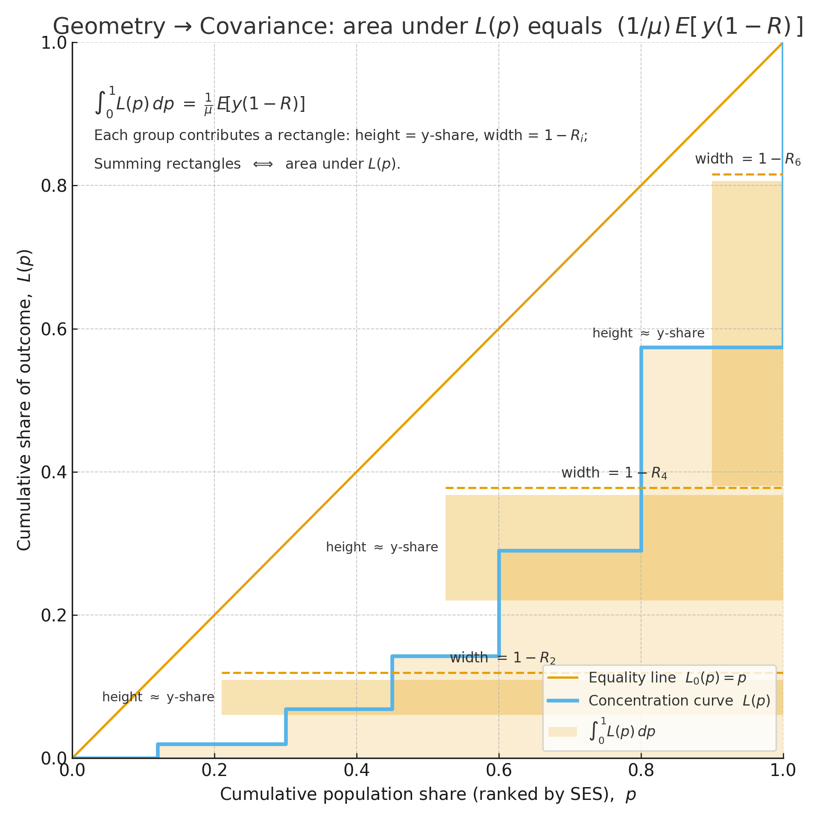
Area under L(p) equals (1/μ) E[ y(1-R) ]: rectangles of width (1−R) weighted by y.

Slide 21
Readings
Wagstaff, Adam & Paci, Pierella & van Doorslaer, Eddy, 1991. "On the measurement of inequalities in health," Social Science & Medicine, Elsevier, vol. 33(5), pages 545-557
Owen O’Donnell, Eddy van Doorslaer, Adam Wagstaff and Magnus Lindelow, "Analyzing Health Equity Using Household Survey Data” The World Bank, Washington DC, 2008, www.worldbank.org/analyzinghealthequity
Notes:
1.Additional references: Amartya Sen (1973) On Economic Inequality (Expanded Edition with a substantial annexe by James E. Foster 1997)

Slide 22
Convenient covariance Method
L(p) = (1/μ) E[ y · 1{R ≤ p} ]
∫₀¹ L(p) dp = (1/μ) E[ y(1 − R) ] (swap expectation and integral; ∫ 1{R≤p} dp = 1−R)
CI = 1 − 2∫₀¹ L(p) dp = (2/μ)( E[yR] − 1/2·E[y] )
CI= (2/μ) cov(y, R)

Slide 23
Convenient Regression Method
Let σ²_{R} = Var(R) and define lhsᵢ = (2 σ²_{R} / μ) yᵢ
OLS: lhsᵢ = α + β Rᵢ + εᵢ
⇒ β = cov(lhs, R)/Var(R)
= (2/μ) cov(y, R) = CI
OLS estimate of β is the estimate of the concentration index.
Also provides, standard error and confidence interval of CI.

Slide 24
Properties of the concentration index
Depend on the measurement characteristics of the health variable of interest.
Strictly, requires a ratio-scaled, non-negative variable.
Invariant to multiplication by a scalar.
But not to any linear transformation.
So, not appropriate for an interval-scaled variable with an arbitrary mean.
This can be problematic for measures of health that are often ordinal.
If the variable is dichotomous, C lies in the interval (μ-1, 1-μ) (Wagstaff, 2005):
  So, the interval shrinks as the mean rises.
  Normalize by dividing C by 1-μ.
Notes:
A ratio scale has a true zero, allowing statements such as “A has twice as much X as B.” That makes sense for dollars or height. But many aspects of health cannot be measured in this way.
The concentration index is invariant to multiplication of the health sector variable of interest by any scalar (Kakwani 1980). So, for example, if we are measuring inequality in payments for health care, it does not matter whether payments are measured in local currency or in dollars; the concentration index will be the same. Similarly, it does not matter whether health care is analyzed in terms of utilization per month or if monthly data are multiplied by 12 to give yearly figures.
Measurement of health inequality often relies on self-reported indicators of health, such as those considered in chapter 5. A concentration index cannot be computed directly from such categorical data. Although the ordinal data can be transformed into some cardinal measure and a concentration index computed for this (van Doorslaer and Jones 2003; Wagstaff and van Doorslaer 1994), the value of the index will depend on the transformation chosen (Erreygers 2006).In cross-country comparisons, even if all countries adopt the same transformation, their ranking by the concentration index could be sensitive to differences in the means of health that are used in the transformation.
The bounds given in the case of a dichotomous measure hold for large samples.

Slide 25
CI bounds for a dichotomous variable: Cmax
For a binary outcome: y ∈ {0,1}, and μ = E(y) = prevalence.
Use: C = (2/μ)E(yR) − 1, with E(R)=1/2.
To maximize CI, place all y=1 persons among the richest μ fraction.
Then their ranks run from (1−μ) to 1.
Average rank of the y=1 group = [(1−μ)+1]/2 = 1 − μ/2.
So E(yR) = μ(1 − μ/2).
Therefore:
Cmax = (2/μ)·μ(1 − μ/2) − 1 = 1 − μ.

Slide 26
CI bounds for a dichotomous variable: Cmin
To minimize CI, place all y=1 persons among the poorest μ fraction.
Then their ranks run from 0 to μ.
Average rank of the y=1 group = [0+μ]/2 = μ/2.
So E(yR) = μ(μ/2) = μ²/2.
Therefore:
Cmin = (2/μ)·(μ²/2) − 1 = μ − 1.
Hence:
μ − 1 ≤ C ≤ 1 − μ
As μ rises, the possible range shrinks.

Slide 27
Numerical illustration
Example 1: μ = 0.20 (20% have the outcome)
Cmin = 0.20 − 1 = −0.80
Cmax = 1 − 0.20 = +0.80
Possible range: −0.80 to +0.80
Example 2: μ = 0.80 (80% have the outcome)
Cmin = 0.80 − 1 = −0.20
Cmax = 1 − 0.80 = +0.20
Possible range: −0.20 to +0.20
Intuition: when prevalence is high, many people must have y=1,
so the outcome cannot be concentrated only among a small rich or poor group.

Slide 28
Binary Outcomes & Normalizations to CI
Wagstaff: C_{W} = C/(1−μ) ∈ [−1,1]
Erreygers : E = 4 μC/ (b-a) ∈ [−1,1]
Where b and a are upper and lower bounds of the health variable.

Slide 29
Total inequality in health and socioeconomic-related health inequality
By definition, the
health Lorenz curve
must lie below the
concentration curve.
That is, total health
Inequality is greater
than SES-related
health inequality.
Notes:
The Lorenz curve for income describes the income distribution. It plots the cumulative proportion of income against the cumulative proportion of the population ranked by income.
A plot of the cumulative proportion of health against the cumulative proportion of the population ranked by health is the health Lorenz curve. Since this runs from the least to the most healthy person, the proportion of health accounted for by the least healthy 10% is necessarily less the proportion of health accounted for by the poorest 10% (unless health and income are perfectly positively correlated).
But for many health variables available from survey data, which are categorical, the health Lorenz curve would not be very interesting since there are relatively few values of health by which to rank. For anthropometric indicators it would be interesting.

Slide 30
Lorenz Curve and Concentration Curve
Lorenz Curve
Concentration curve
Lorenz curve is a widely measure of income inequality.
It is a graphical presentation of cumulative % of population (starting from poorest) against cumulative % of income/wealth
It uses only one variable, distribution of population by income/wealth
In deriving Lorenz curve, we arrange the income data in ascending order and than cumulate the distribution
We plot the cumulative % of population against the cumulative % of income
The diagonal line is the line of perfect equality where inequality is 0
Concentration curve is a widely measure of health inequality
It is a graphical presentation of cumulative % of health variable against the cumulative % of population ranked by income/socio-economic status
It usages two variables; health and income
In deriving concentration curve, we arrange the health data by rank of income
We plot the cumulative % of health variable against the cumulative % of income
The diagonal line is the line of perfect equality
Concentration curve can be above the diagonal line/ below the diagonal line

Slide 31
Demographic standardization of the concentration index

Slide 32
Demographic standardization of the concentration index
Standardize for the total correlation with demographic confounding variables (x).
Model y on need variables z ⇒ ŷ = E[y|z]
Indirectly standardized outcome: y_{IS} = y − ŷ + μ (preserves mean)
CI_{IS} on y_{IS =} CI_{y} − (μ_{ŷ} /μ) CI_{ŷ}

Slide 33
Decomposition of CI (Wagstaff)
Decomposition is a useful explanatory tool for partitioning inequality.

Slide 34
Decomposition of the Concentration Index
  For any linear additive explanatory model of ‘health’ (y) such as :
  The concentration index of y can be decomposed (Wagstaff et al, 2003):
  where μ is the mean of y, is the mean of x_{k}, C_{k} is the concentration index for x_{k} , GC_{ε} is the generalized concentration index for the error term (residual), and η_{κ} is the elasticity of y with respect to x_{k} .
Notes:
For ease of exposition, we will refer to any health sector variable, such as health or health care use or payments, as “health” and to any (continuous/ordinal) measure of socioeconomic status as “income.”
Wagstaff, van Doorslaer, and Watanabe (2003) demonstrate that the health concentration index can be decomposed into the contributions of individual factors to income-related health inequality, in which each contribution is the product of the sensitivity of heath with respect to that factor (the elasticity) and the degree of income-related inequality in that factor (the respective concentration index).
That is, the concentration index for the health variable of interest, y, can be written as a weighted sum of the concentration indices of the k regressors, where the weight for xk is the elasticity of y with respect to xk .
The residual component—captured by the last term—reflects the income-related inequality in health that is not explained by systematic variation in the regressors by income, which should approach zero for a well-specified model.

Slide 35
Decomposition of CI (Wagstaff)
Elasticity of y w.r.t. x_{k}: = (β_{k}·x̄_{k}) / μ (%change in y per 1-unit change in x_{k} relative to its mean).
CI of determinant x_{k} : CI{x_{k}} = (2 / x̄_{k}) · cov(x_{k}, R).
Contribution of x_{k} to CI_{y}: = Elasticity(x_{k}) × CI of determinant x_{k}
Percent contribution: = Contribution of x_{k} to CI_{y} / Total CI of y
Residual term: GCε / μ, where GCε = 2·cov(ε, R) (unexplained inequality/ residual).
Large Elasticity and CI{x_{k}} ⇒ large |contribution; signs indicate whether x_{k} increases or reduces inequality.

Slide 36
HAZ (Height-for-Age Z-score)
HAZ (Height-for-Age Z-score): WHO-standardized anthropometric index for child linear growth/ malnutrition.
Z = (X− Median of reference population) / SD (Reference population)
Interpretation: HAZ<−2 → stunting

Slide 37
Stata Practice

